Slide 1
timeout
timeout
$ADROT
,
[0…4]_{rotary ID}
,
[0…9]_{position}
\r\n
$FSACK\r\n
S
$ADVER,1.00\r\n
wrong version
$FSBA1
,
[0…9]{4}
$ADNAK\r\n
$FSVER,1.00\r\n
$ADACK\r\n
$FSBA2
,
[0-9]{4}
$FSROW
,
[:print:]{0,24}
\r\n
$ADACK\r\n
$FSOFF
,
LCD|BA1|BA2
$FSON
,
LCD|BA1|BA2
$FSTGV
,
0-255_{accu}
,
0-255_{brkL}
,
0-255_{brkR}
unknown
$ADNAK\r\n

Slide 2
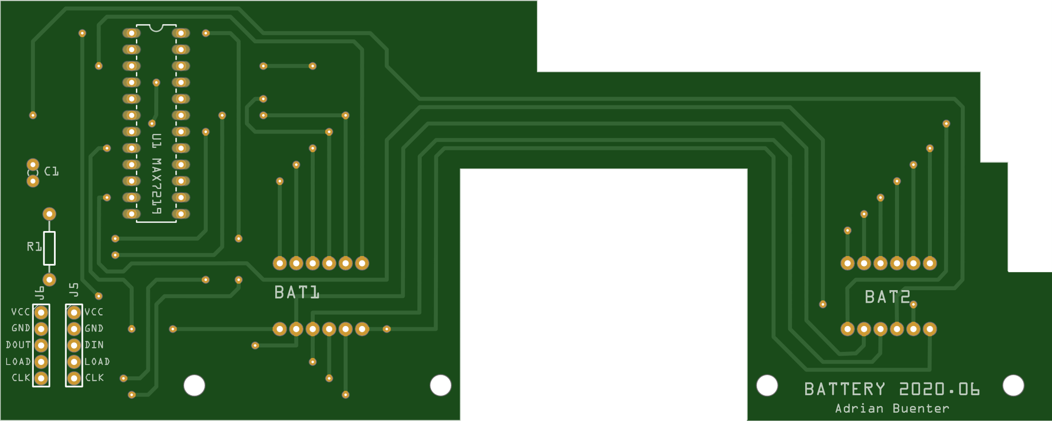
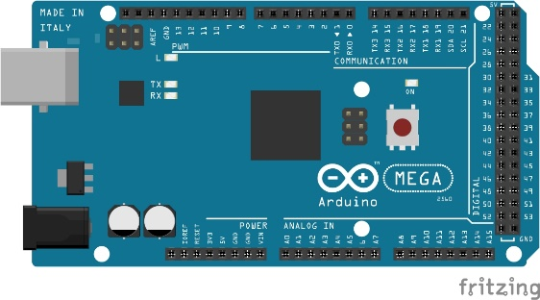
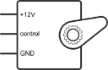
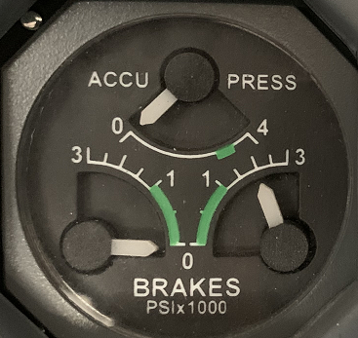
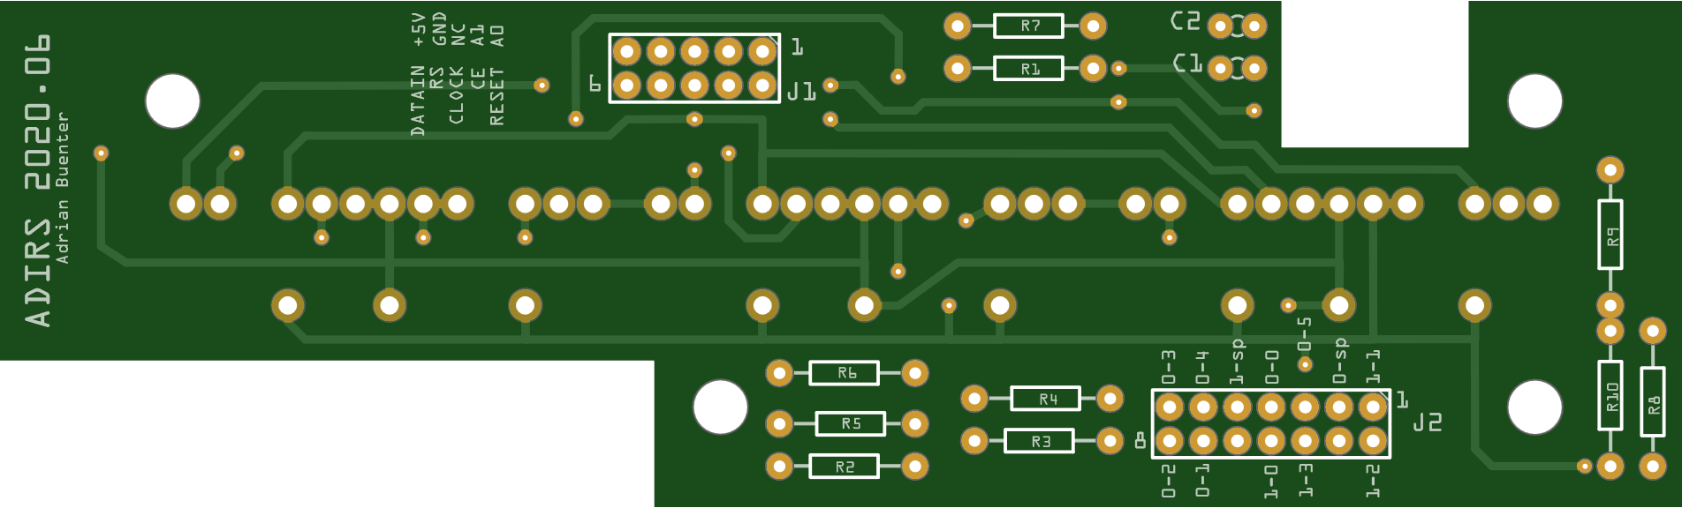
Digital: D10, D11, D12 (MAX7219)
Battery BAT1 and BAT2 display
Arduino MEGA 2560
USB: PC runing FSUIPC
PWM: D7, D8, D9 (servo)
3x servo of Triple Gauge
DATA
SYS
Analog: A2
Analog: A3
Analog: A4
Digital: D2, D3, D4, D5, D6 (3x HCMS-2912)
Analog: A0, A1 (rotary)
IR1
IR3
IR2
ADIRS display (24 characters) and rotary switch encoder to analog

